Slide 1


“Employee Leave Management System”
Submitted by : Naresh Babu O
Submission type : Individual
Name: Naresh Babu O
Batch :HDFC API Batch-1
LMS Id :
Program :Full Stack Development
Date: 15/04/2023

Slide 2

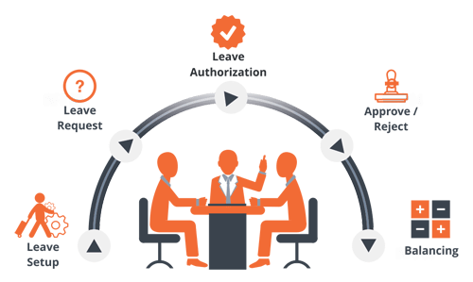

Slide 3
Submitted by
NARESH BABU O
HDFC API Developer Batch-1
in Manipal Global Skill Academy

Slide 4
Supervisor:
Mr. Javeed Mohammed
trainer from Manipal global skill academy

Slide 5
Technologies
JAVA-8
Spring boot
Rest API
My SQL
Spring Data JPA
Swagger
Validation
Junit

Slide 6
Executive Summary:
This documentation is provides some information about Employee Leave management System. The Employee Leave management System application is responsible for applies leave, calculation of leave, and leave approval. This application components related to an employee's "Leave Life cycle" while at an organization. These activities include the Enterprise Structure, Cross-Application Components and Organizational Management.

Slide 7
Acknowledgement:
I would like to mention our sincere gratitude towards Manipal lobal Skills Academy , for giving us the opportunity to carry out our Project. I would like to express our heart full gratitude towards our guide, Mr. Javeed for valuable advice for the successful completion of this dissertation.
I also like to extend our sincere thanks to the staff of Manipal Global Skill Academy for their invaluable help and support.
Finally, I take this opportunity to mention our sincere thanks to one and all those who helped us directly or indirectly for the completion of our project

Slide 8
1.1 Background of the project:
In the existing Leave Management System, every organization follows manual procedure in which employee enters information in a record book. At the end of each year, Administration Department calculates leave/s of every member which is a time taking process and there are chances of losing data or errors in the records . This module is a single Employee Leave Management System that is critical for HR tasks and keeps the record of vital information regarding working leaves. It intelligently adapts to HR policy of the management and allows employees and their line managers to manage leaves and replacements (if required). In this module, Head of Department (HOD) will have permissions to look after data of every employee of their department. HOD can approve leave through this application and can view leave information of every individual.

Slide 9
Possible Solution
Above are certain objectives that should be gain in this project :
To apply leave online (staffs)
To receive leave application from staff and to approve or reject staff leave (Approver)
To calculate leave balance from a fix amount of annual leave
To record all leave information in database To generate report based on staffs leave

Slide 10
Fact and Finding
Leave Management System is the important system in administration department in all company.
However, the management is different for each company.
Some company still comfort with the manual System and the other make change the system from manual to computerize to make the management more effective

Slide 11
Methodology :
What to use
In this system development, OOAD (Object-oriented System Analysis and Design) is the best approach than traditional structured approach. This methodology is using UML (Unified Modeling Language), the object oriented approach has the potential to reduce errors, reduce costs, and increase flexibility because of its inherent features.
The development of the project consists of five SDLC (Software Development Life Cycle) phases.

Slide 12
1. Planning Phase
In this phase, the first step is making a research in finding the best project to propose. After get Information about the project, proposal is submitted. The proposal consists of the project background, problem area, objectives and project requirements. This is the most important thing to do in phase planning .
Besides that, the faculty has accommodated a flow that need to be follow by the student. From the schedule, the student can plan the best way in managing time to develop the project. Gantt chart are develop base on schedule and time that given by the lecturer to submit those entire thing needed.

Slide 13
1.1.Analysis Phase
First of all, the analysis has to done to know the view of whole system to develop. The content of the proposal is the result from the analysis .
In this chapter, the important thing need is make more research to captured key functionality. system process and tolls needed. This finding and research can be done via internet, journal, books and tide. The finding should be described and elaborate in diagram, chart and table to make the system easier to understand in process of develop later.
Many analysis must done to know the business process of the as-is System and to-be-System.
Analysis about requirement and functionality of the System is very important in process to develop the System

Slide 14
I.2 Design Phases
Based on the analysis phase, the design will be done. The design phase is consisting of 3 activities . The activities area.
a. Logical design
This activity involves class diagram and interaction diagram.
b. Interface design
The activity includes navigation design, output design and input design.
c. Database design
This activity defines logical data model, detail explanation for each entity, description of the association, cardinality and relationship.

Slide 15
1.3 Testing Phase
In this phase, the all functionality system are testing and confirm that there are no error and record the entire not function requirement and correct it
1.4 Implement Phase
After all phase have been perfectly done, the system will be implemented to the server and the system can be used.
Why to use
Project management ensures that available resources are used in the most effective and efficient manner. It is a combination of steps and techniques to keep a project's schedule and budget in line.

Slide 16
Management Plan:
In-charges and approver are encouraged to work with all employees who have added extra leave to develop an excess Employee Leave Management Plan (ELMP) to reduce the liability. An ELMP is an agreement between the employee and employer that designates actions for reducing excess leave accrual in a timely manner. This may involve setting leave dates, arranging for a cash payment leave, or formally deferring leave (all subject to Industrial Agreement/Award conditions). An ELMP must also take into consideration the additional leave that will fall due during the ELMP timeframe.

Slide 17
How Project Working ?:
Employee:
• Applicant can apply for leave to the system
•HR can See number of day when apply for leave after all deduction of public holiday and official holiday
•Able to see total, applied/ pending, Approved and balanced leaves for each leave type Have to input from date, to date, leave type, reason, description and his/her approver
Approver:
• Approver can see a leave requests as a list
•After his approval he will got a mail also the applicant of the leave request
• Add leave type
• Add Leave Reason
• Add public holiday

Slide 18
Department in-charge:
He will approve after approval of approver
The System will automatically update balance in balance table
And The applicant can check the status of leave request in request table

Slide 19
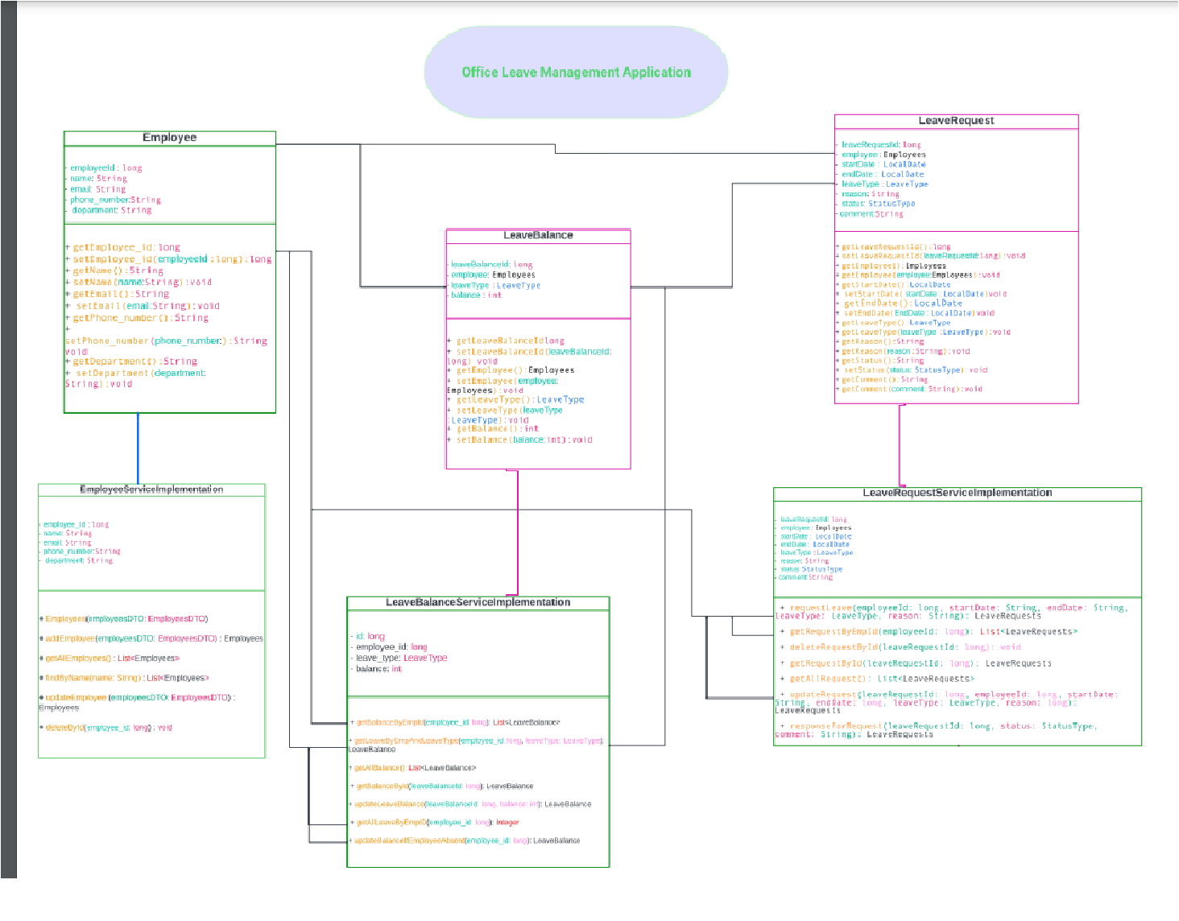
LMS Class Diagrams:

Slide 20
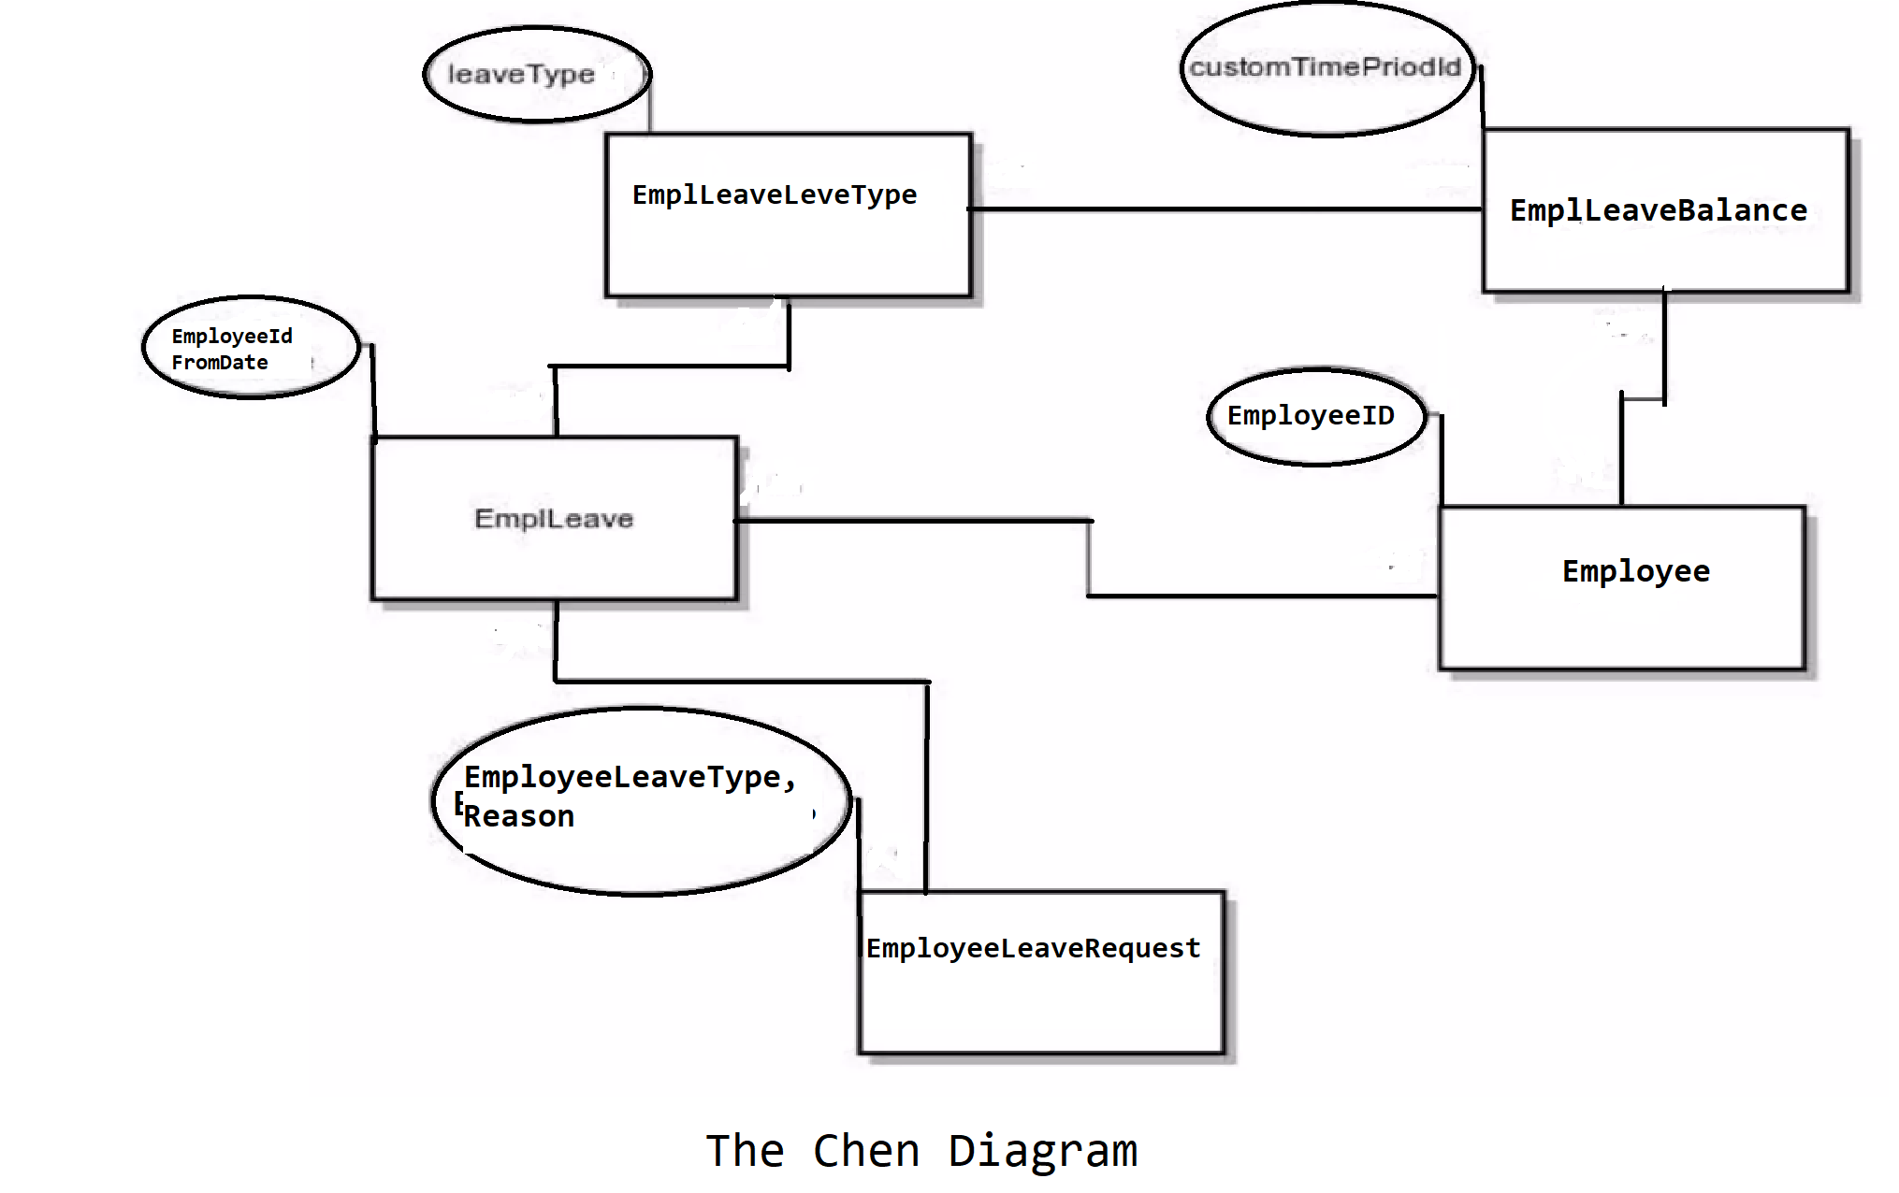
The Chen Diagram

Slide 21
Observation
They are related to the expected internal financial performance of the organization
The goal of this organization actually pursues, how manage the leave easily for employee
* Save cost
* Save overhead time
* Save data for future use
* Increase performance in work efforts
* Gain employee satisfaction

Slide 22
Possibility Solution
Proposed system interface is so user friendly
Web based so anywhere user can access though internet
Manage data into database so data is secured and schedule backup script will be run in background
Time save to overhead costing will be minimized
Overall Requirement List

Slide 23
ENTITY CLASS

Slide 24
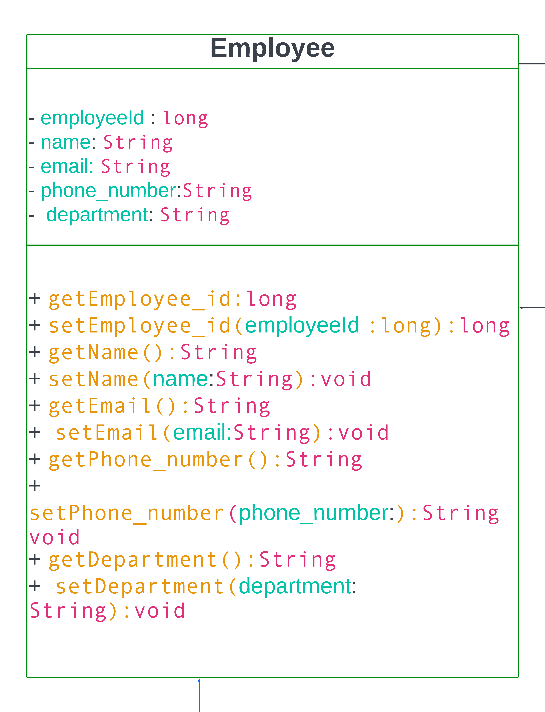
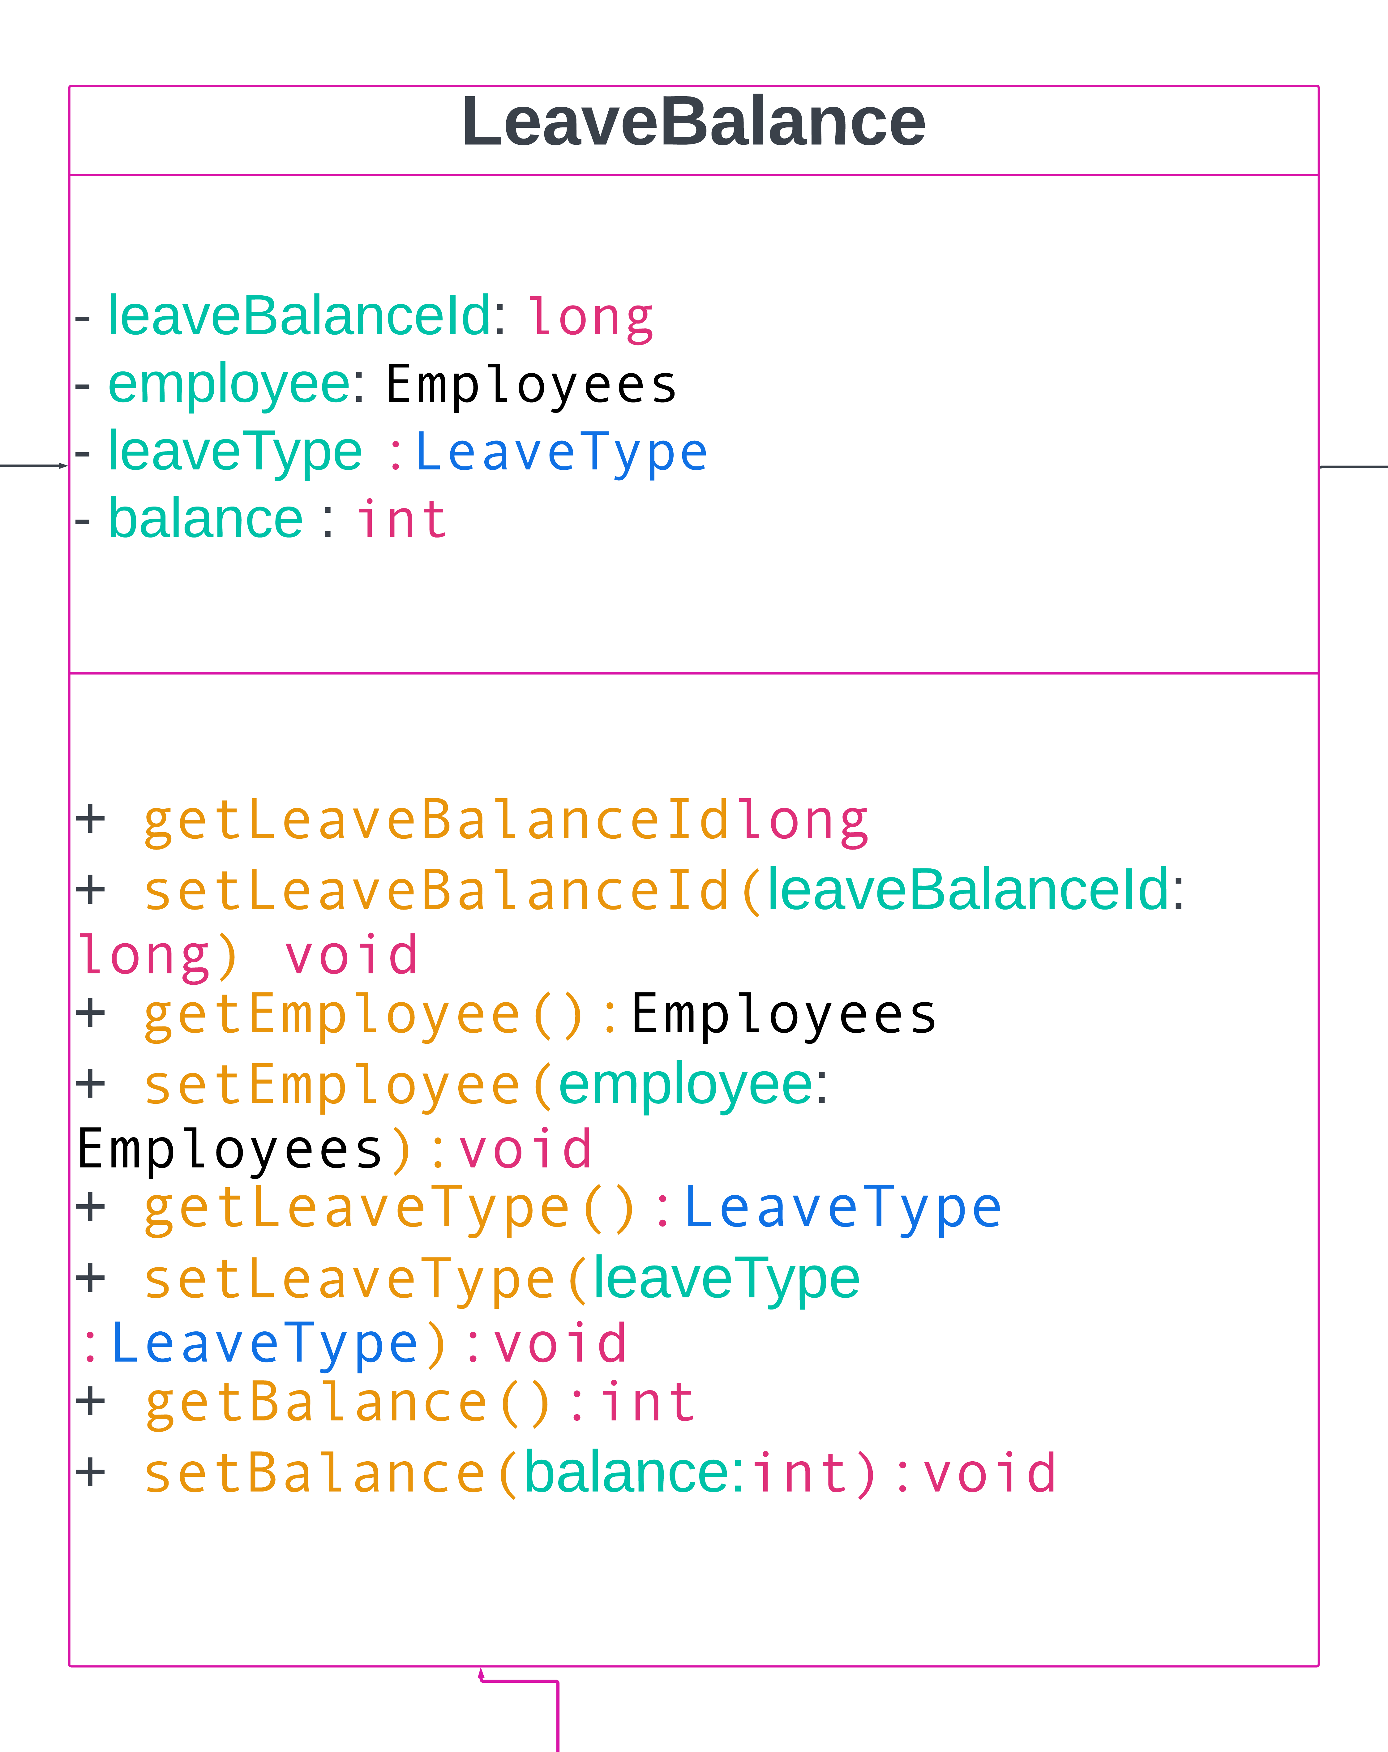
Entity Class Diagrams

Slide 25
BUSINESS LOGIC CLASS

Slide 26
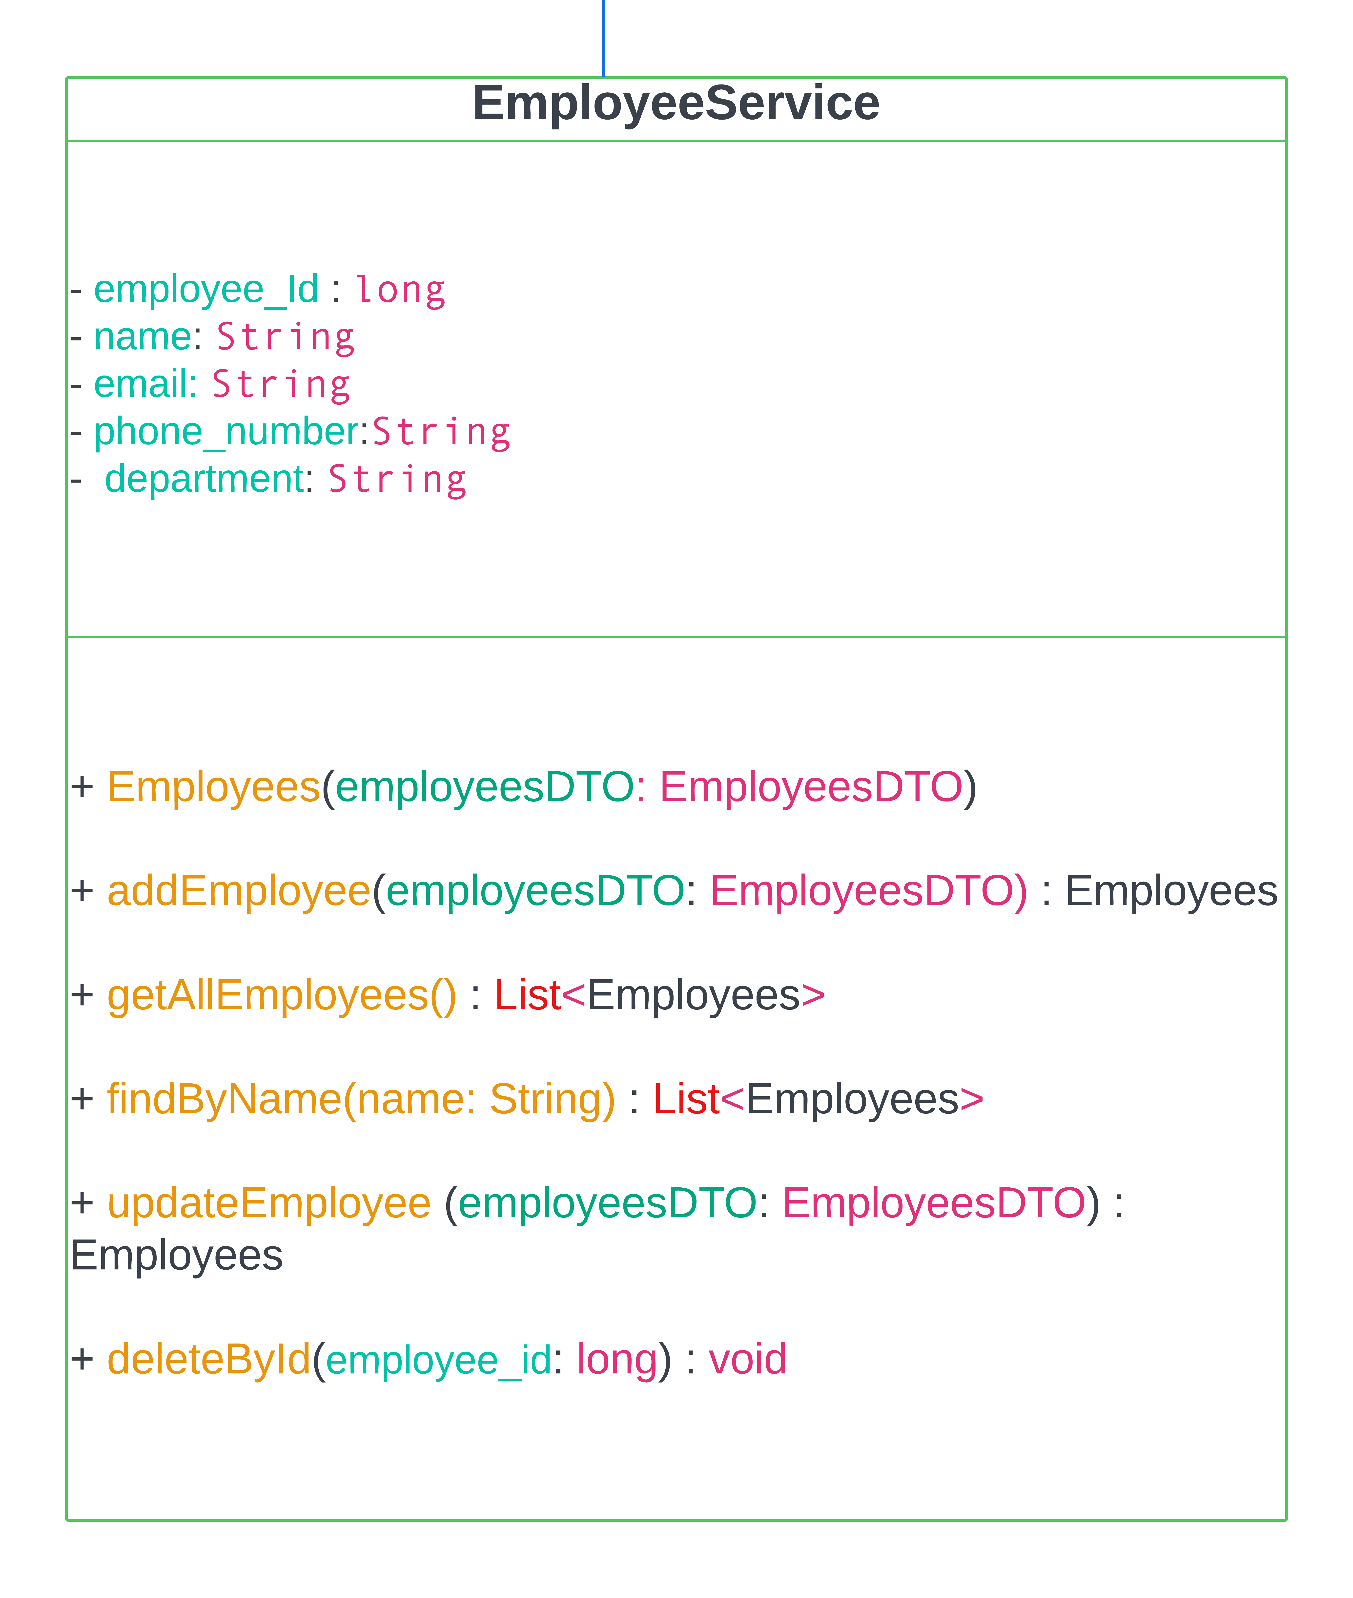
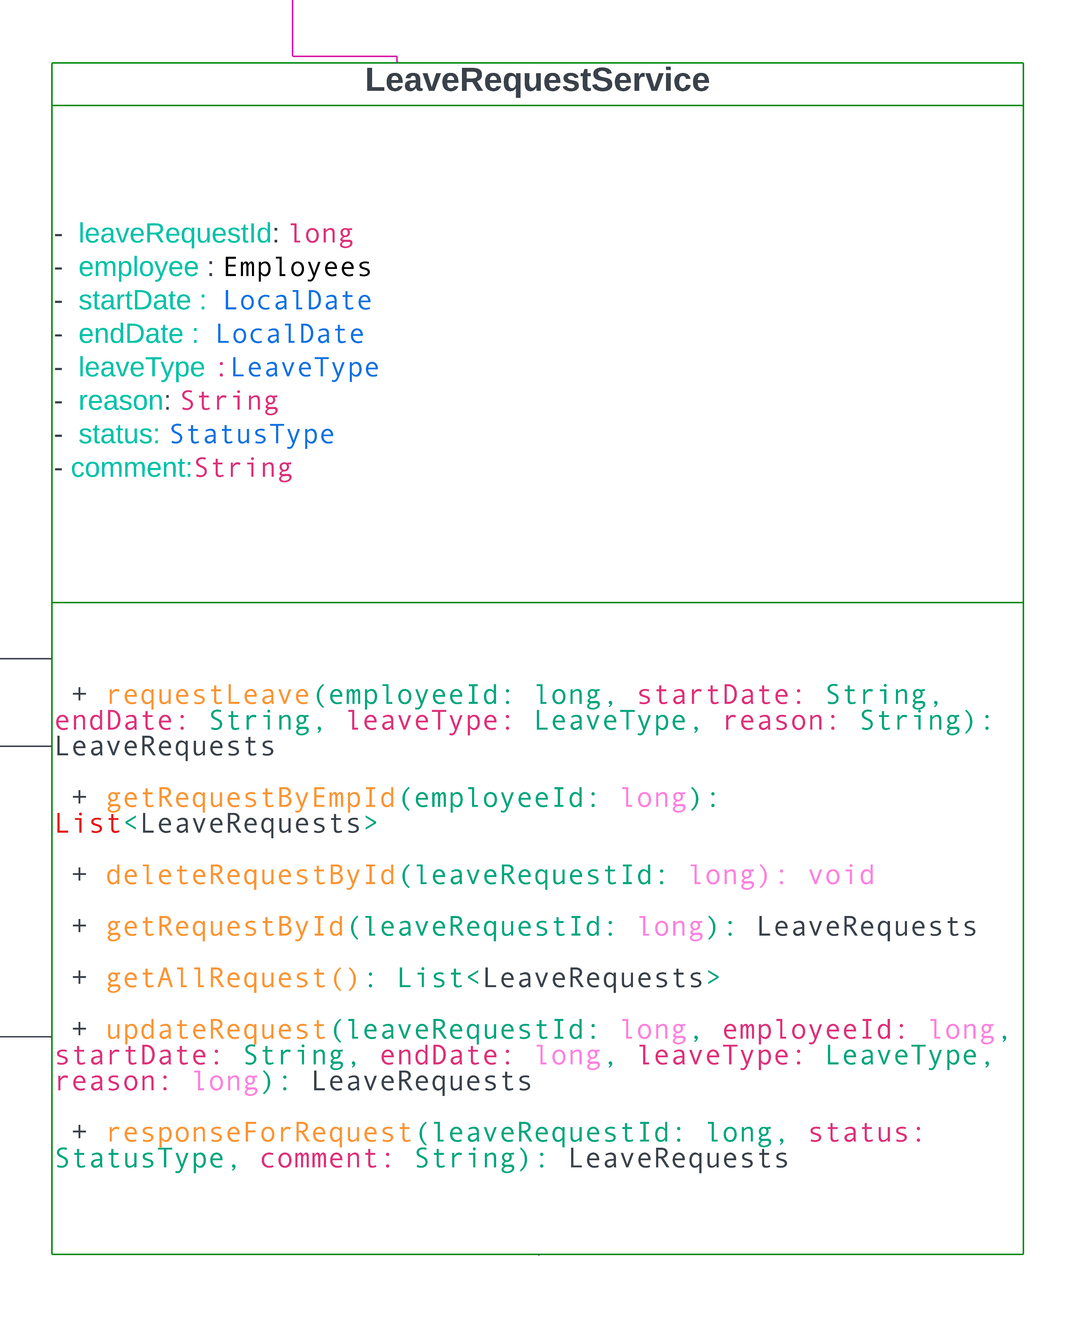
Business Logic Class

Slide 27
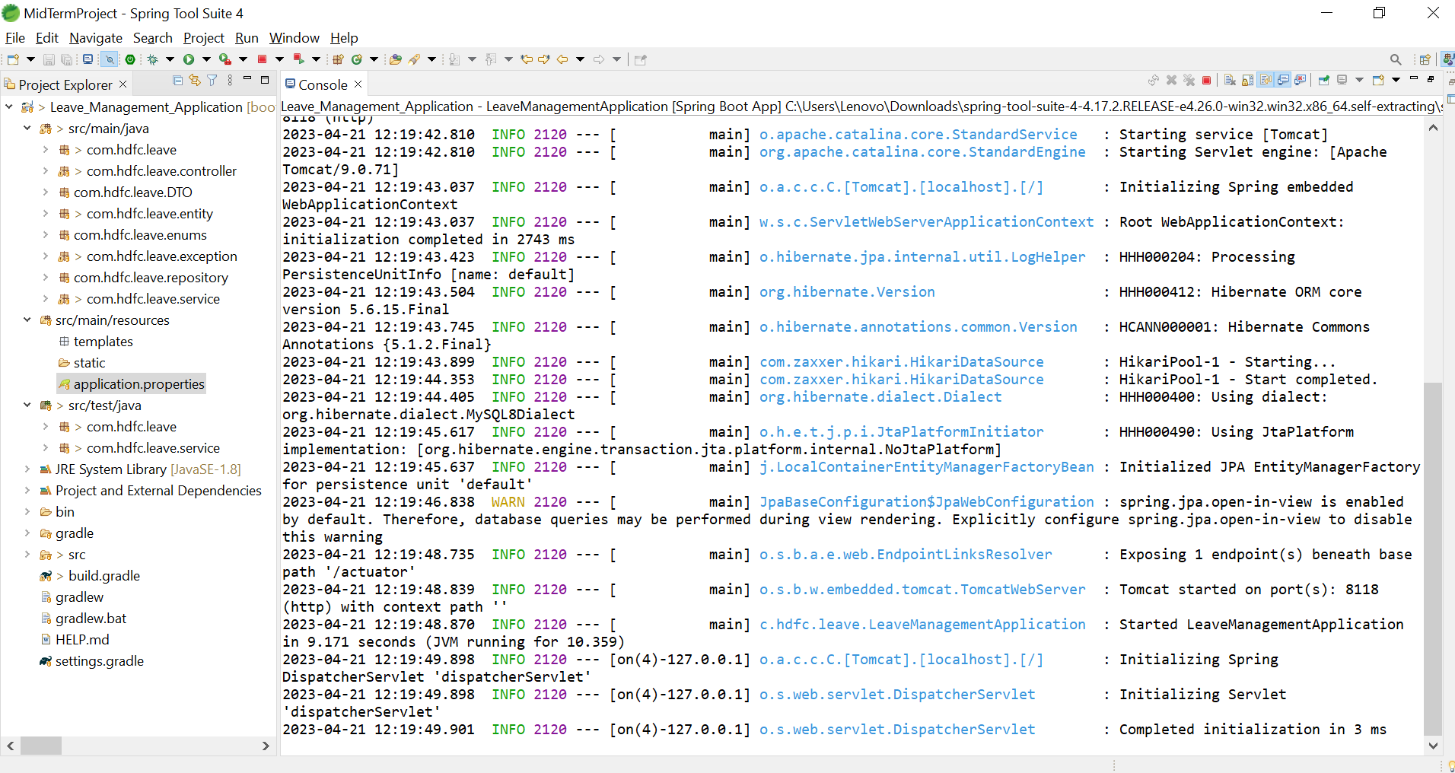
LMS Project- using STS-4 tool:

Slide 28
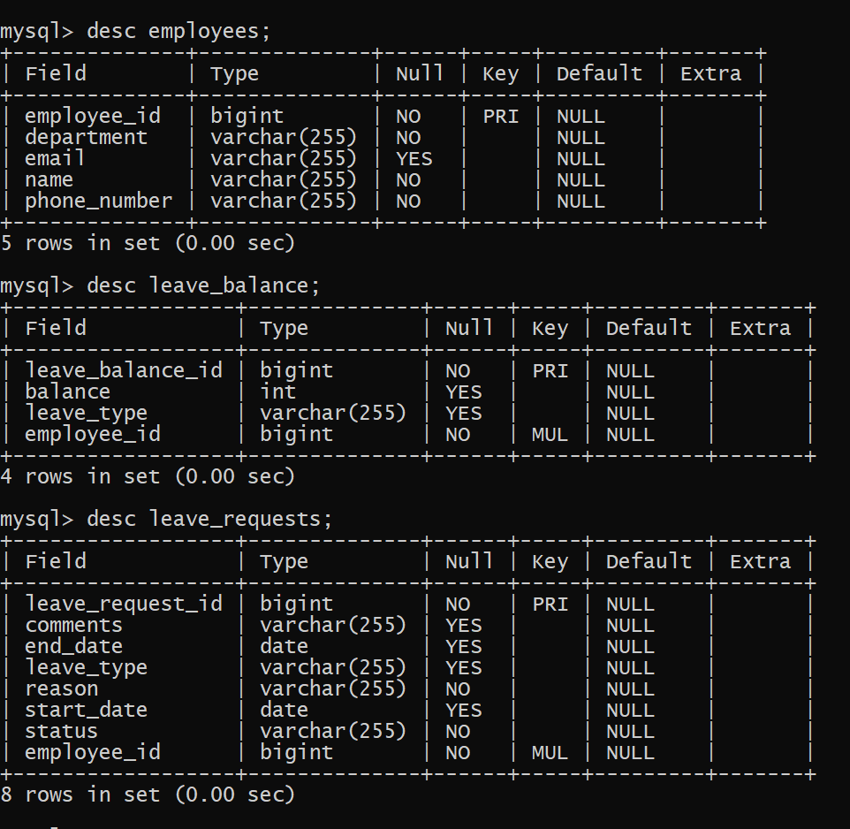
Database(mysql):

Slide 29
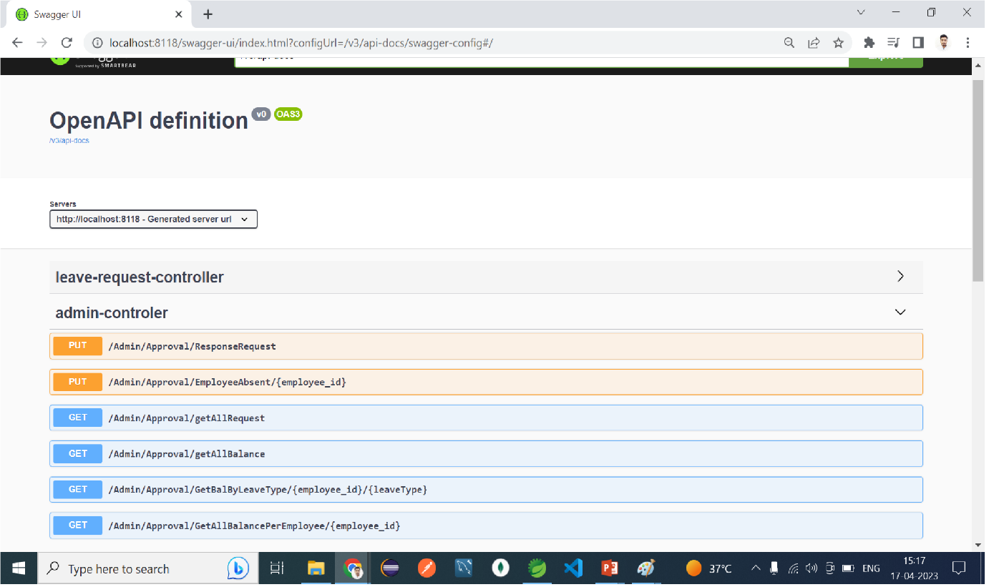
Using Swagger-UI:

Slide 30
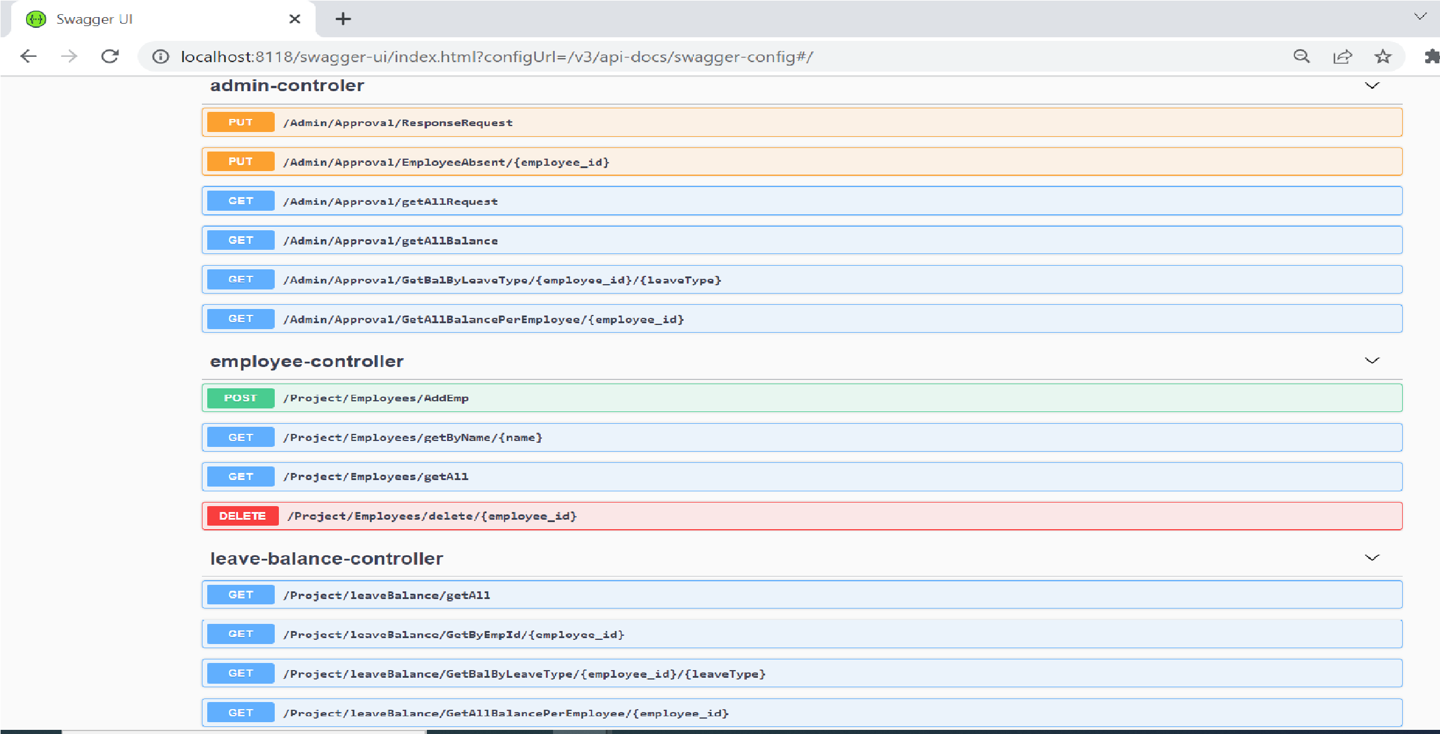
Using Swagger-UI

Slide 31
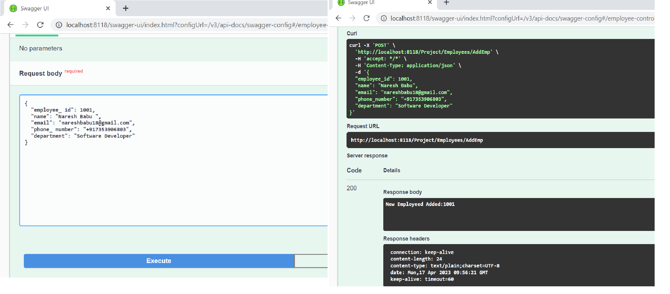
Adding Employee with Output in swagger

Slide 32
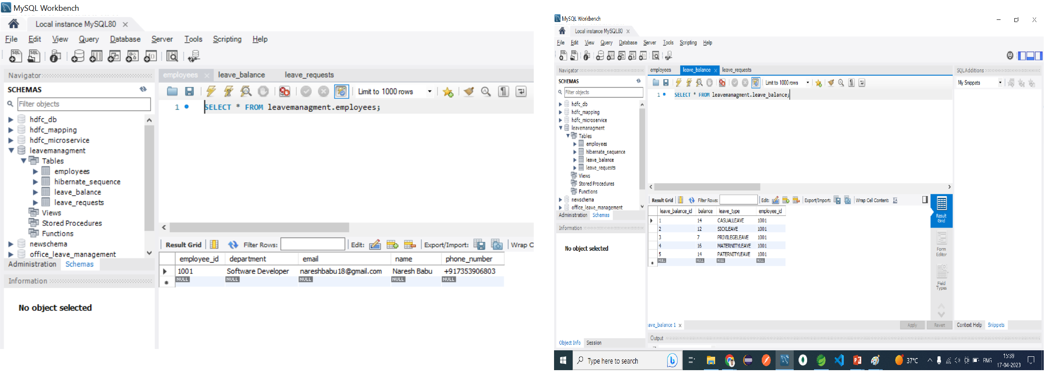
Database table update:

Slide 33
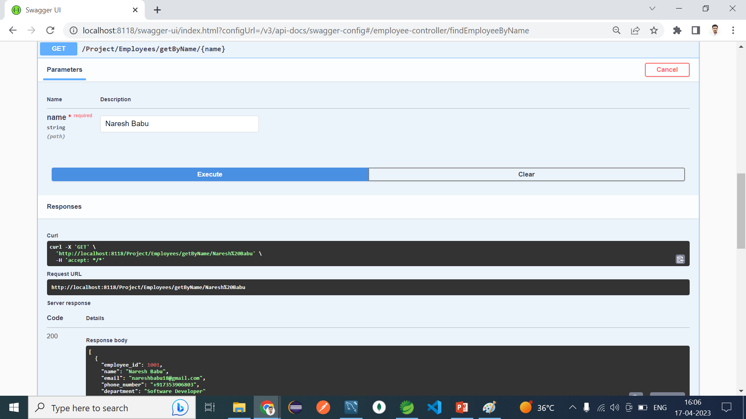
Search By Name:

Slide 34
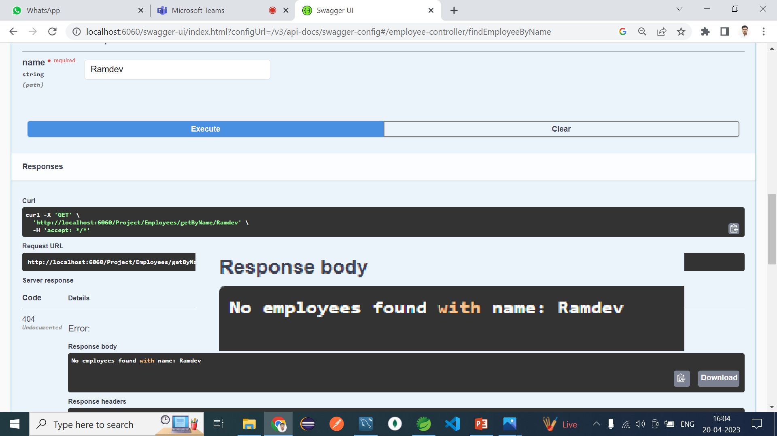
Employee Not Found Exception

Slide 35
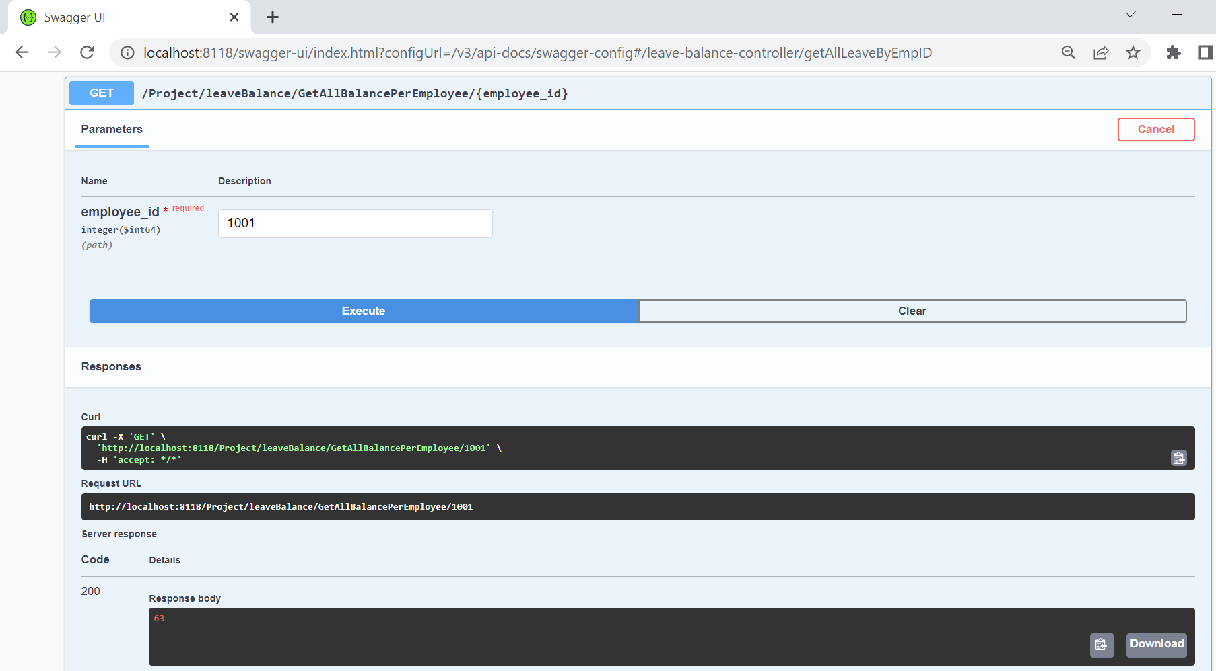
Get Balance By Employee ID

Slide 36
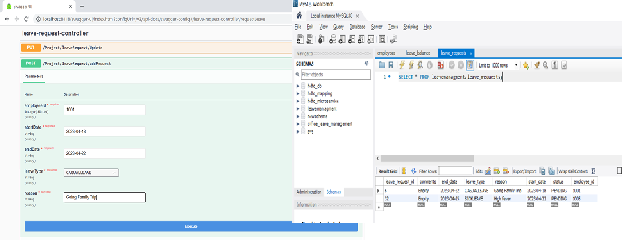
Adding Leave Request:

Slide 37
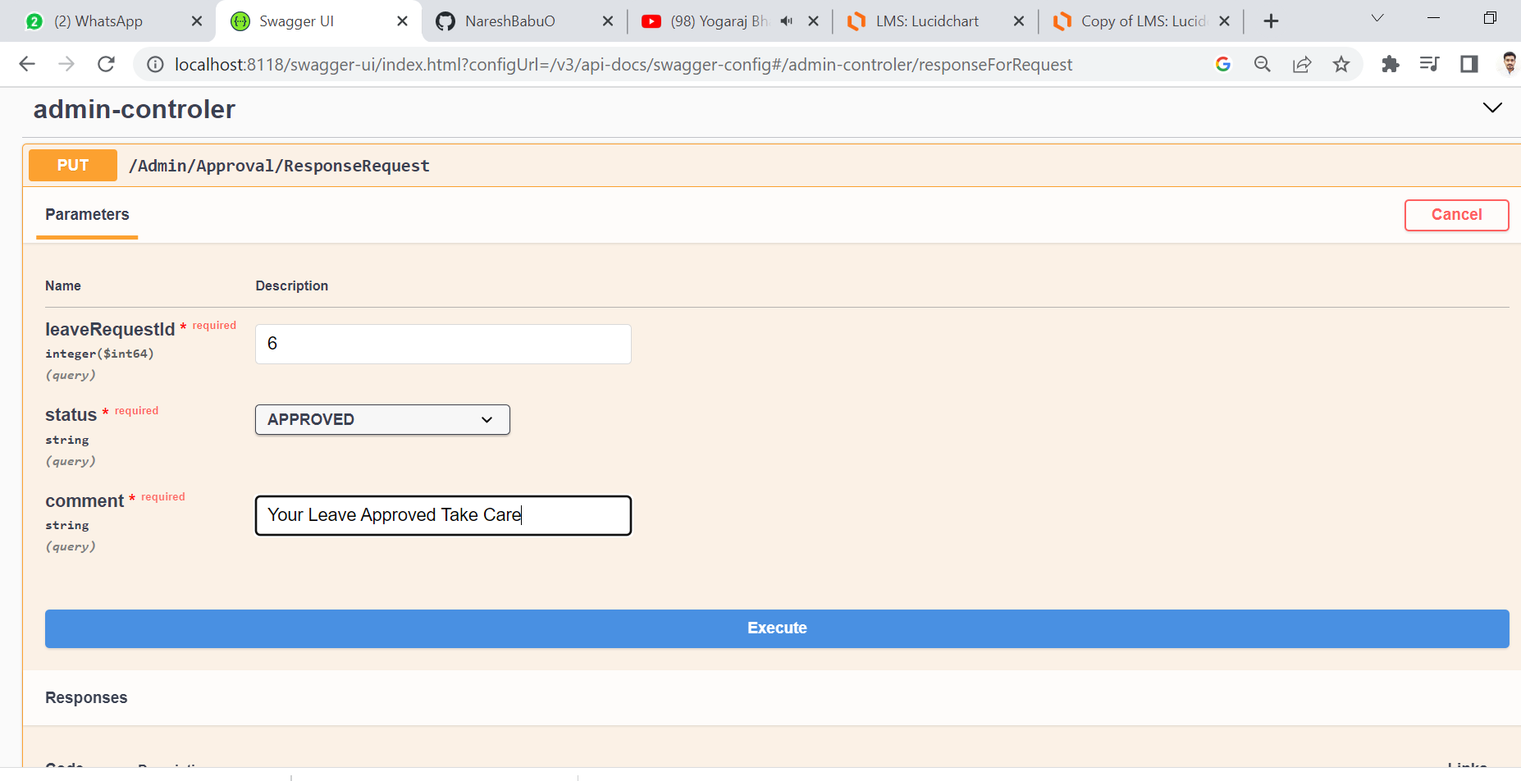
Leave Approval By Admin

Slide 38
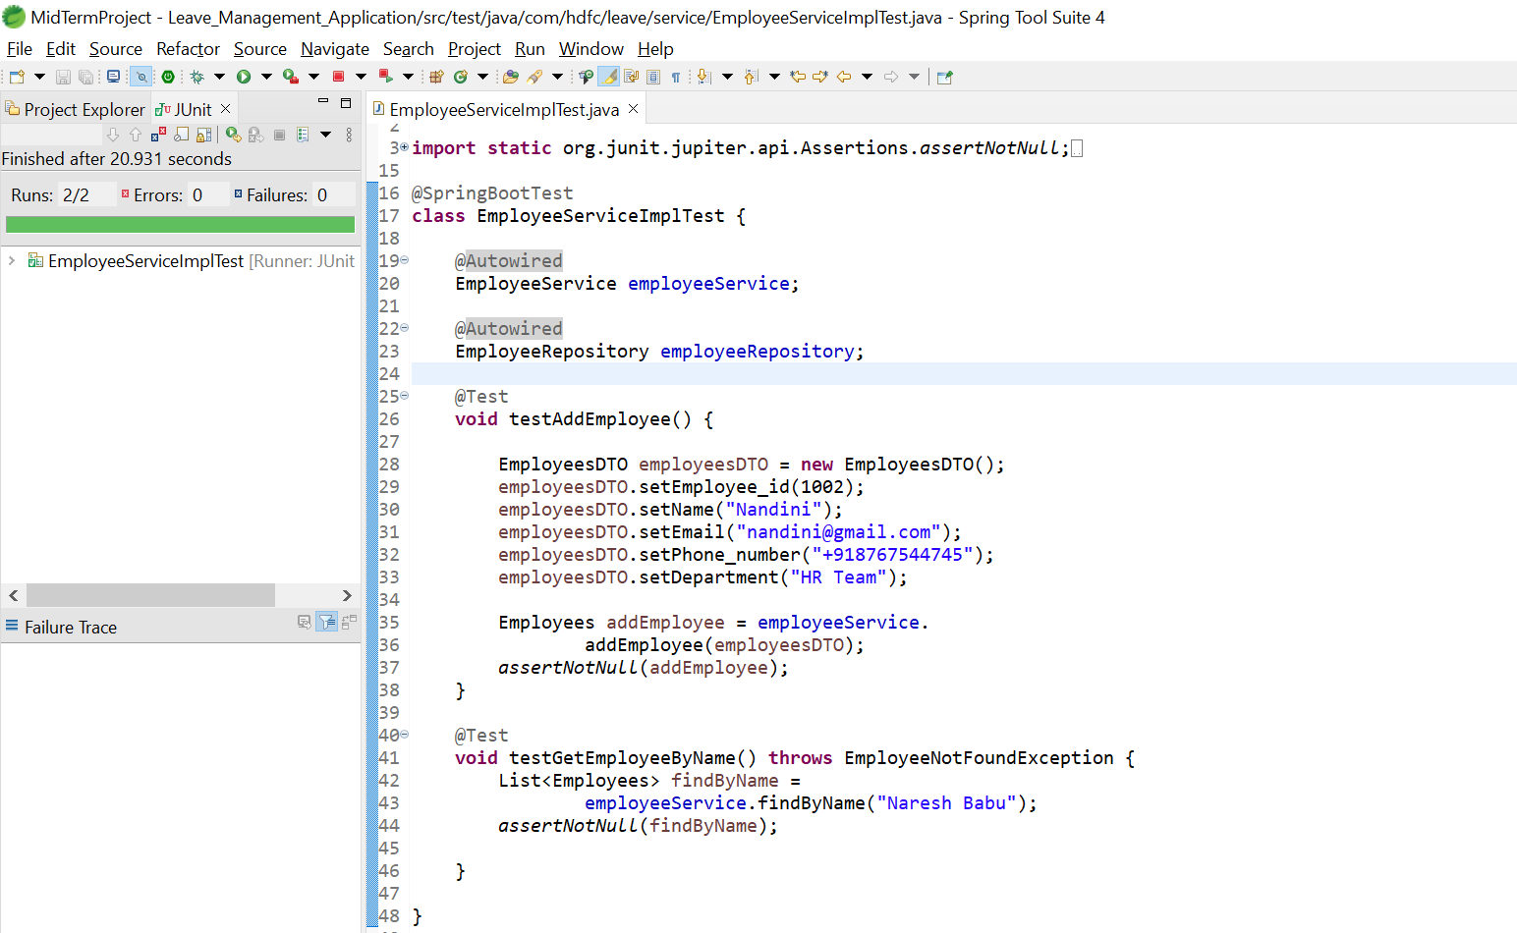
Junit Testing:

Slide 39
Conclusion of LMS Project
The proposed Leave Management System will make the whole leave management process efficient. Users will be able to know their leave status.
The employees may be applying for leave from their home as well. This supporting software will help the management in decision making in case of leave related affairs.
Moreover, it will ensure less paper works and as a result the whole process will be swift and reliable.

Slide 40
THANK YOU

